Slide 1
Title: Project Management-Art, Science or Bull?
Presented By: raymond Sexton, Chartered ENGINEER
Date: 29-OCT-2015

Slide 2
Disclaimer & Acknowledgements
In preparation of this talk I have drawn on a wide range of sources for material to reinforce my thesis that Project Management is Art, Science and/or Bull? This original idea was published in a Primavera Brochure over a decade or so ago.
I have chosen photos to illustrate my thesis and I have resisted the temptation to put in print my insights to allow me be more honest and forthright in the spoken word.
In the unlikely event I offend someone it is not intended and I humbly apologise in advance.
© Raymond Sexton 2015
Notes:
2

Slide 3
Project Management
Project Management is a combination of Art, Science and Bull!
Successful project management is achieving the optimum balance between these three elements
Notes:
3

Slide 4
Art
Art – The ability of a project manager to paint a picture encompassing all human and physical aspects of a project, ensuring each player in the master plan can visualise his or her role and contribution to the bigger picture, determines the stature of the project manager as an artist.
Notes:
4

Slide 5
Science
Science – The science aspect of a project encompasses the correct application of proven methodologies for quantification, monitoring and analysis of key project metrics to assist the artist to communicate with the tangible world.
Notes:
5

Slide 6
Bull
Bull – In all projects there comes a time when neither art nor science provide a viable solution to the challenge being faced. The true project manager then, with humour, lateral thinking, or bull waves the red flag for that final rally!
Notes:
6

Slide 7
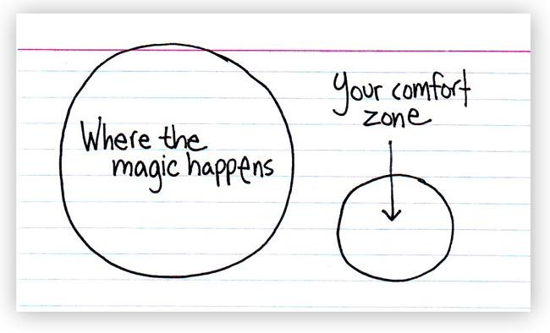
Being Proactive!
Click to add content
Notes:
7

Slide 8
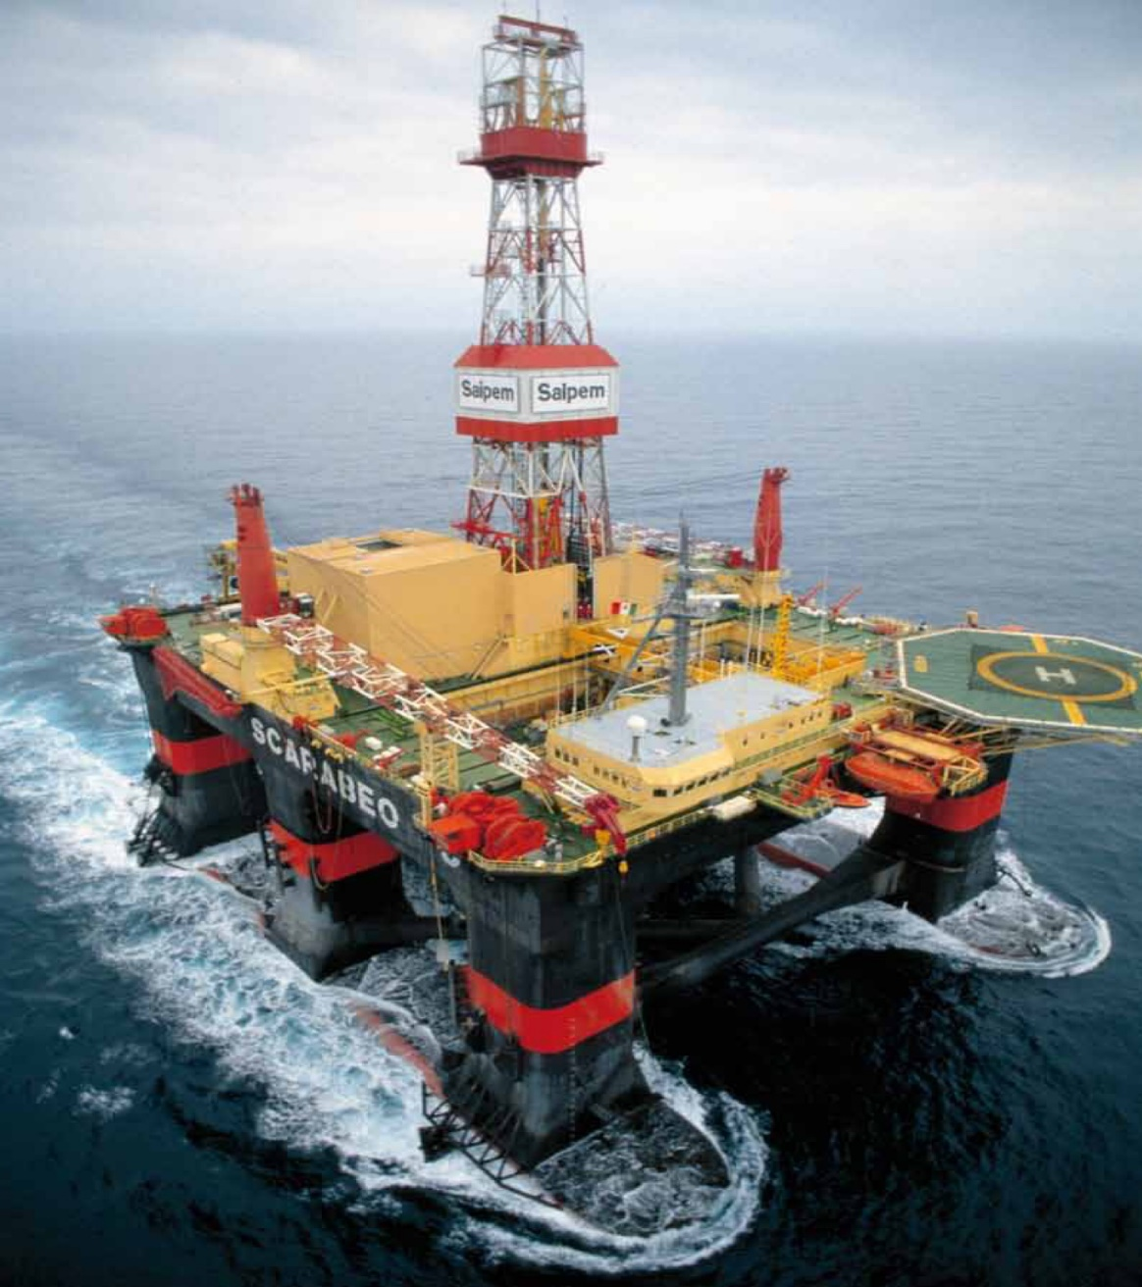
In at the deep end!
Notes:
8

Slide 9
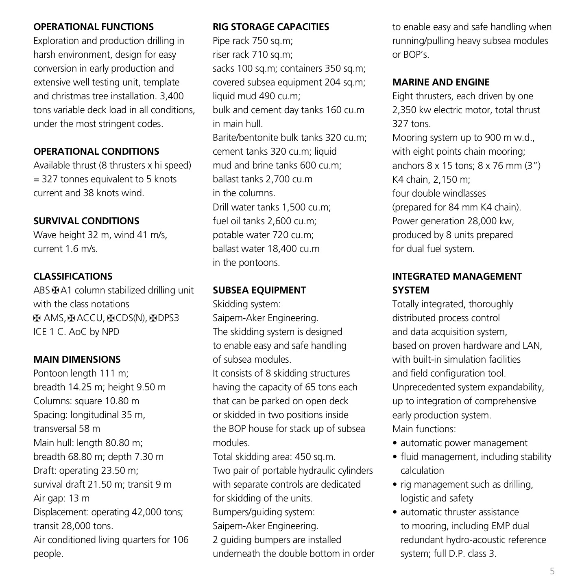
Semi-Sub Details
Notes:
9

Slide 10
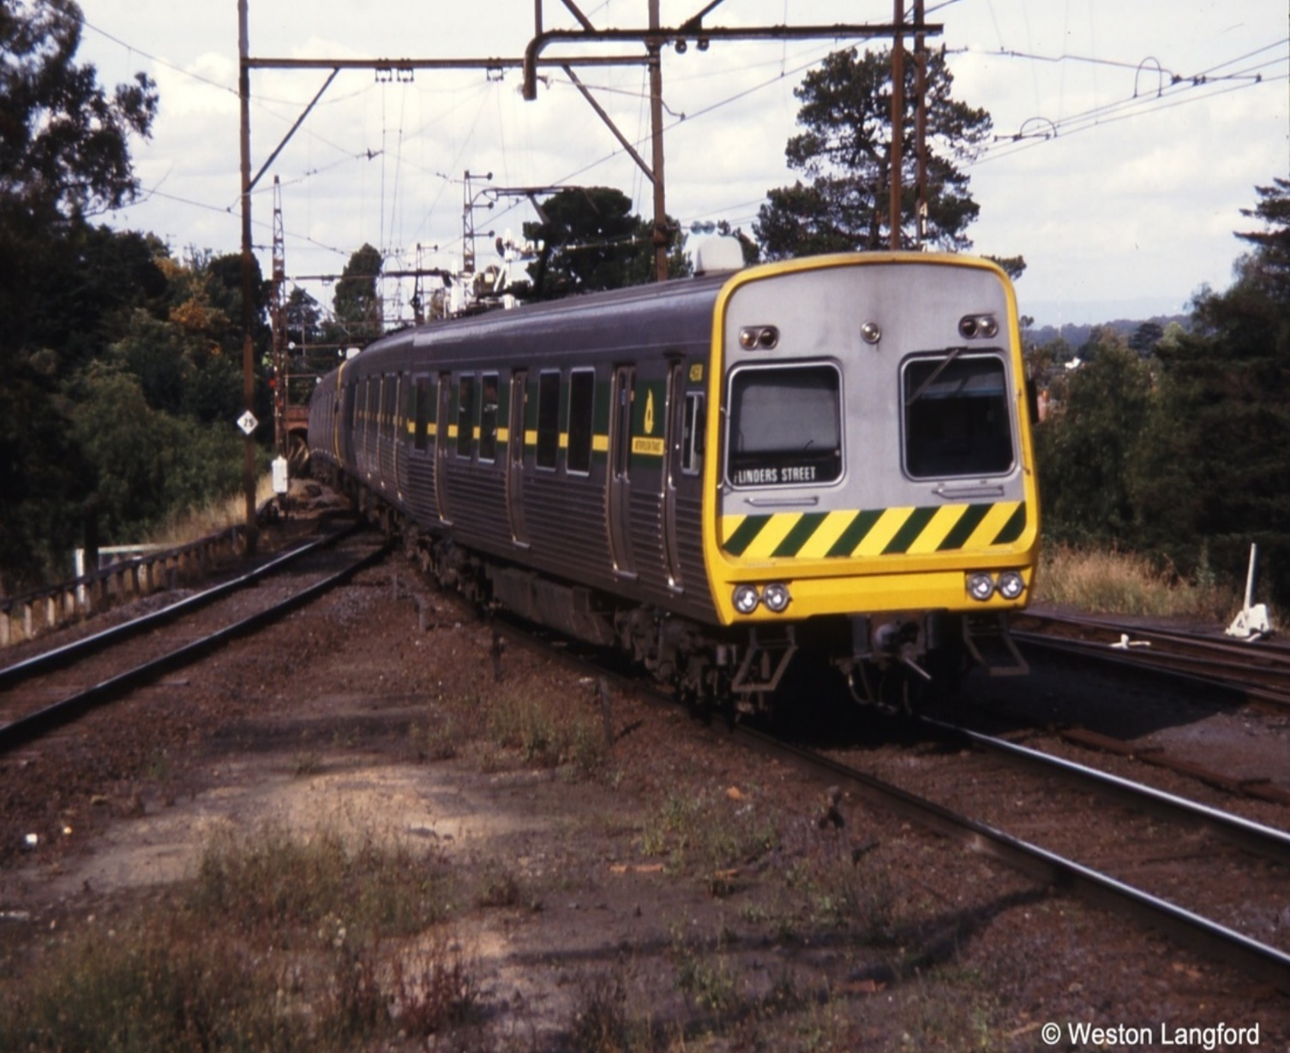
Working on the Melbourne Railways
Notes:
10

Slide 11
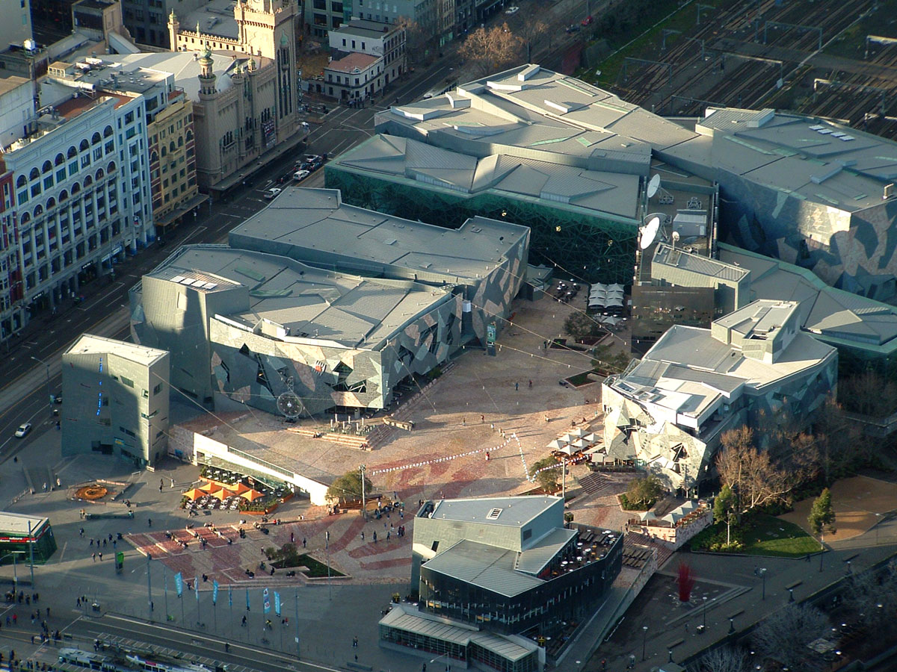
Joilmont Railyards →→ Federation Square
Click to add content
Notes:
11

Slide 12
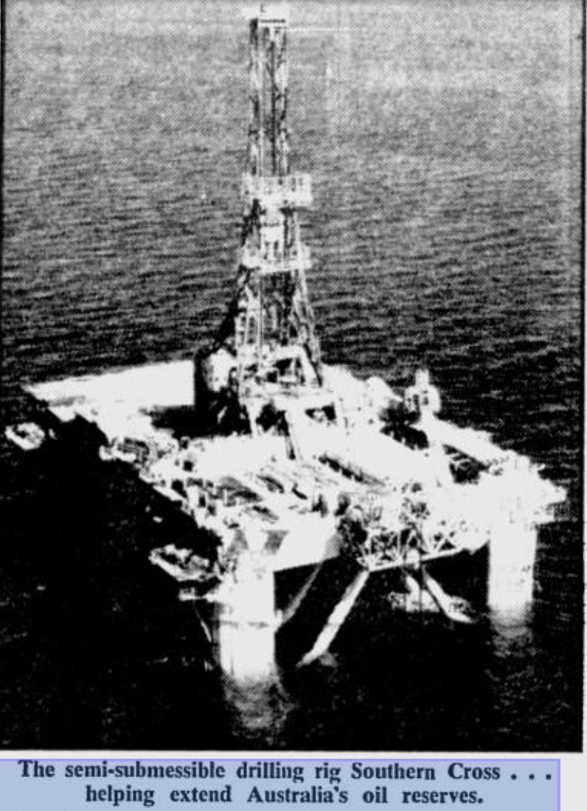
Moving a BOP!
Notes:
12

Slide 13
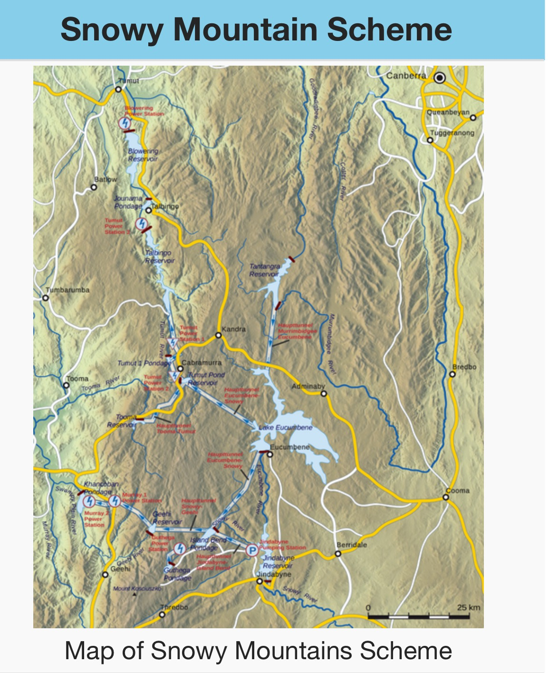
Snowy Mountains Hydro- Small Valve Repair?
Notes:
13

Slide 14
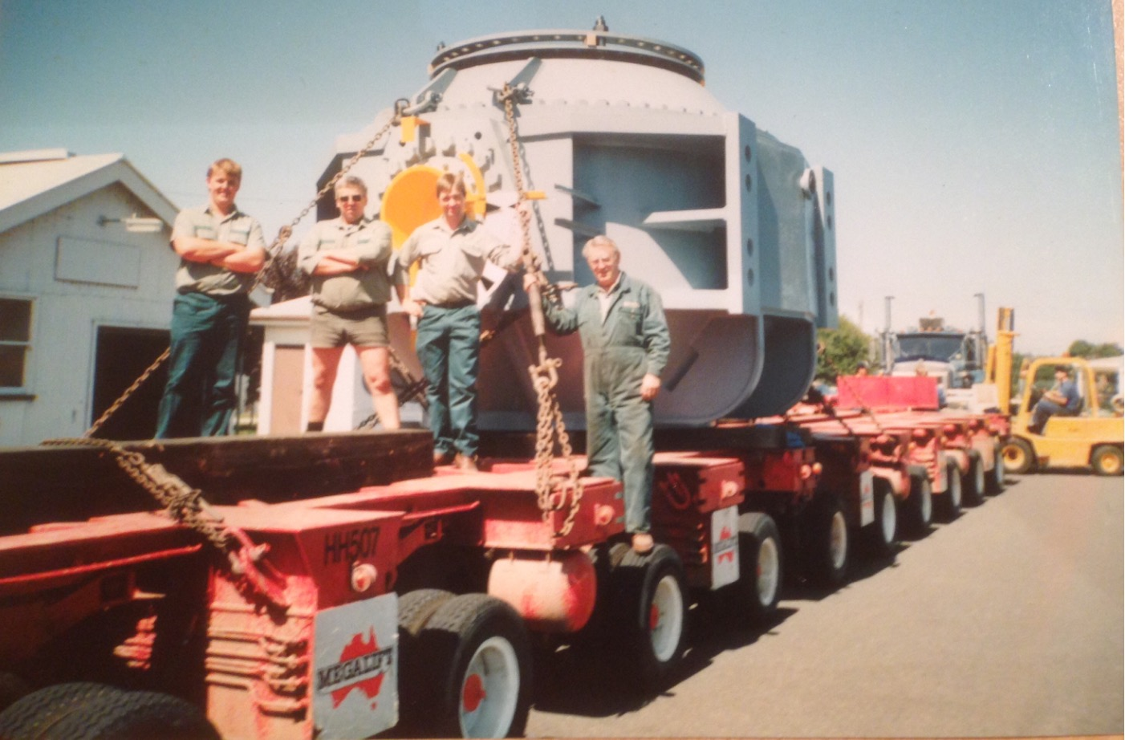
Little Valve
Notes:
14

Slide 15
HiSmelt
Notes:
15

Slide 16
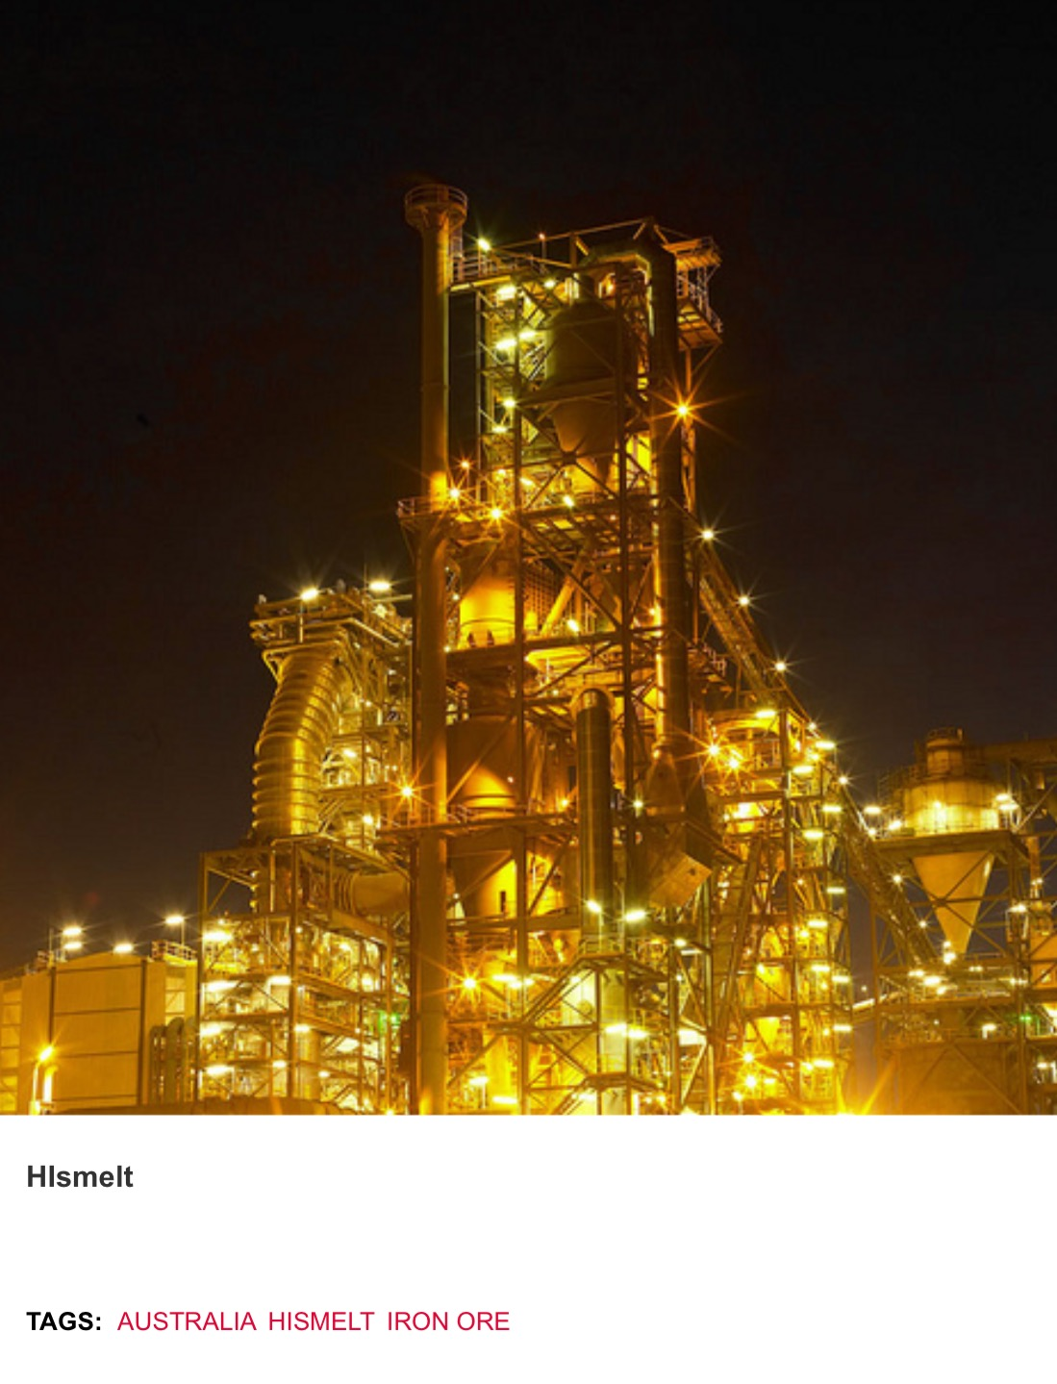
HiSmelt
Notes:
16

Slide 17
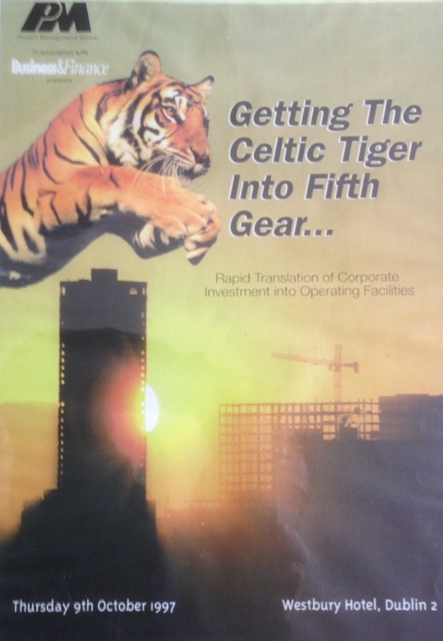
You’ll be on your own!
Notes:
17

Slide 18
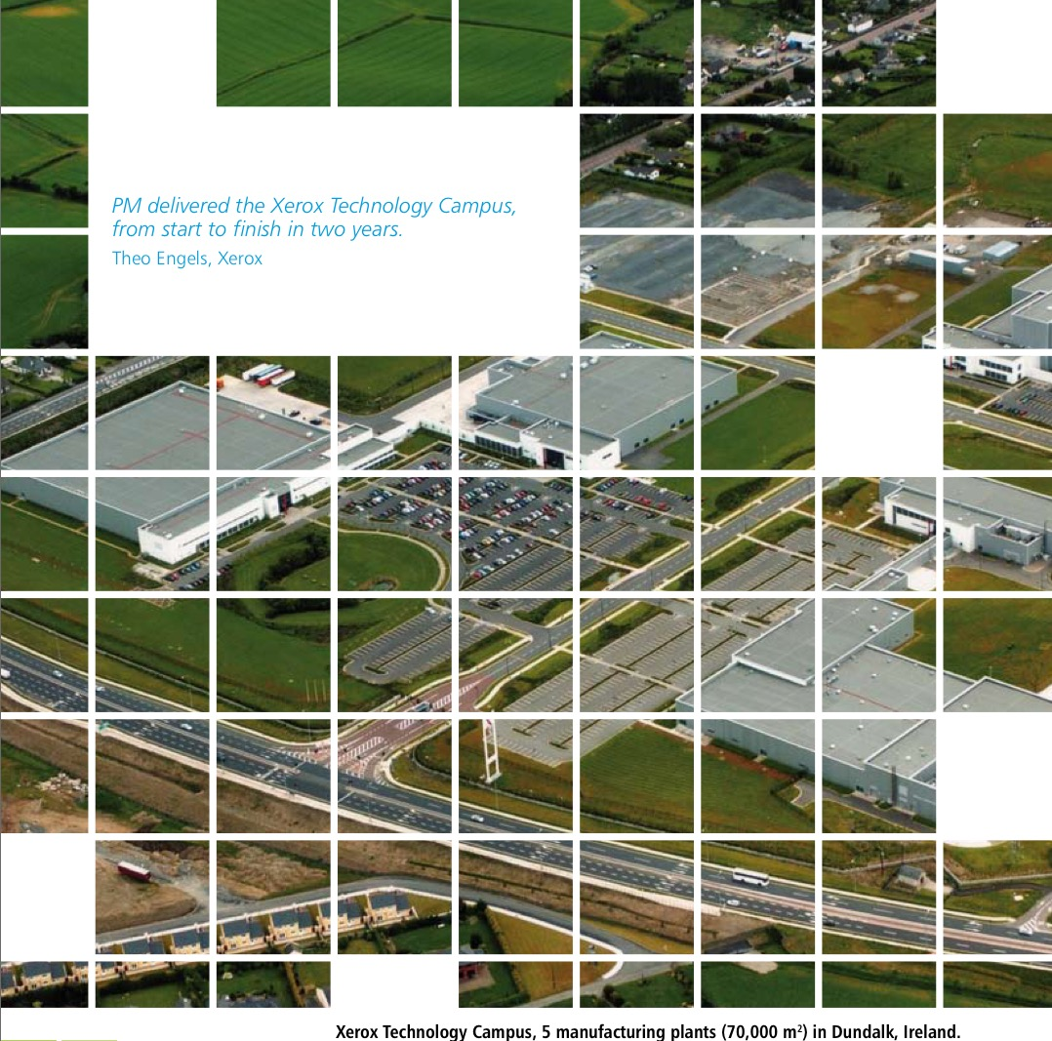
Xerox-hard to copy?
Notes:
18

Slide 19
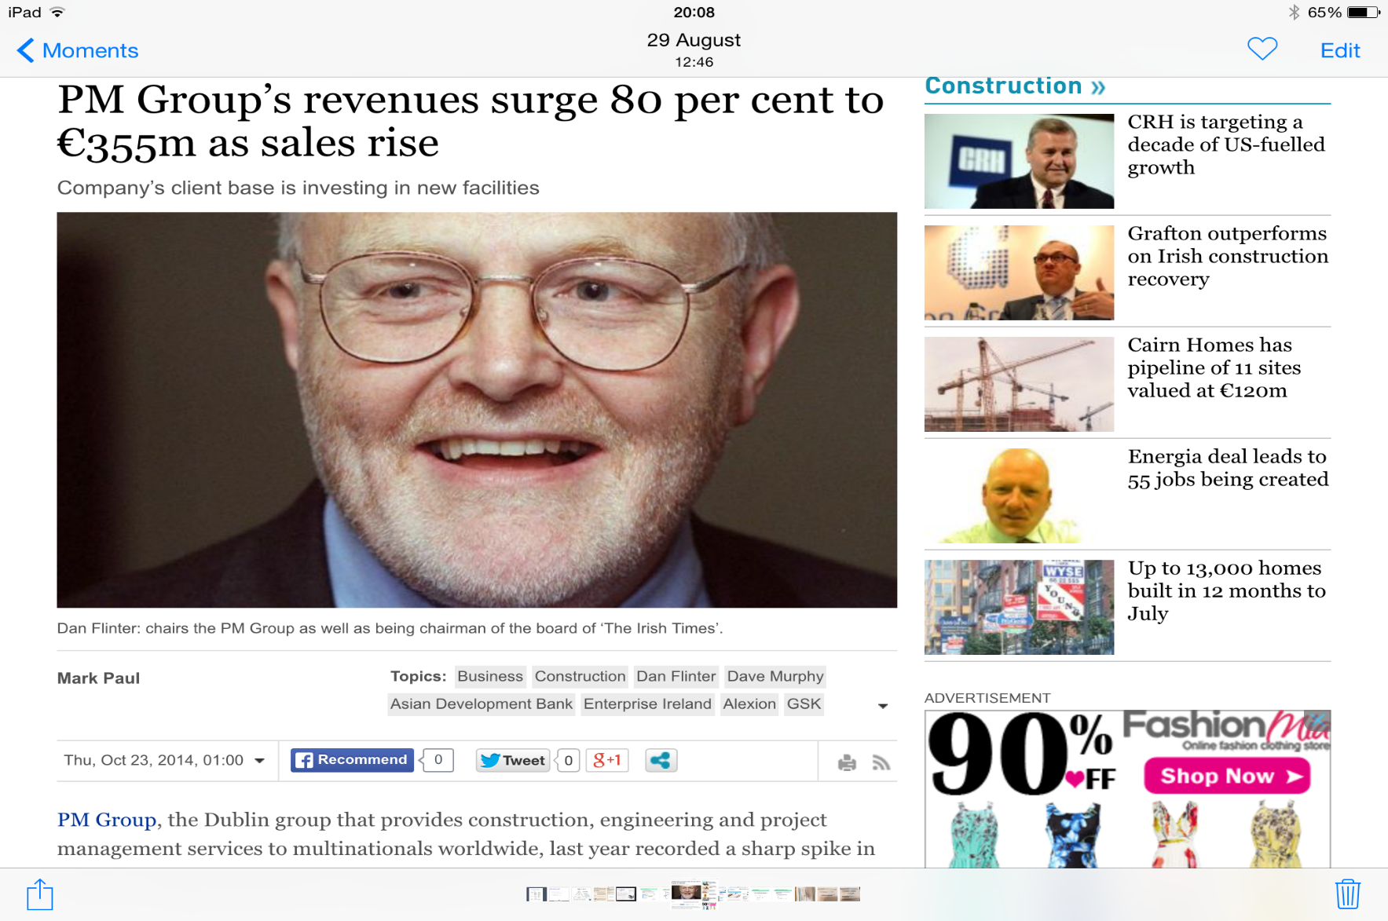
Proud of your former colleagues!
Notes:
19

Slide 20
Acknowledging Other Disciplines: Marketing
Notes:
20

Slide 21
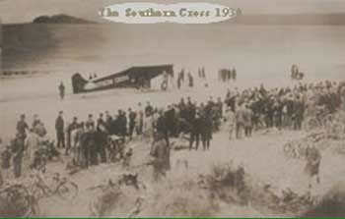
Southern Cross-1st Circumnavigation of the Globe
Click to add content
Notes:
21

Slide 22
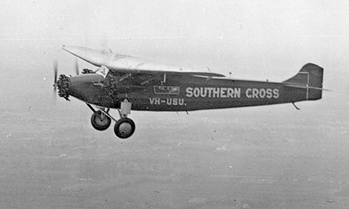
Southern Cross in full flight!
Click to add content
Notes:
22

Slide 23
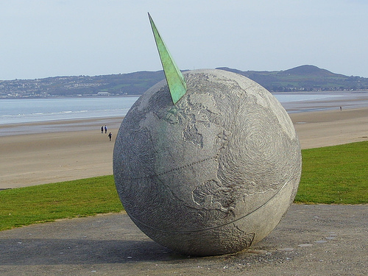
Southern Cross Monument-’Eccentric Orbit’
Notes:
23

Slide 24
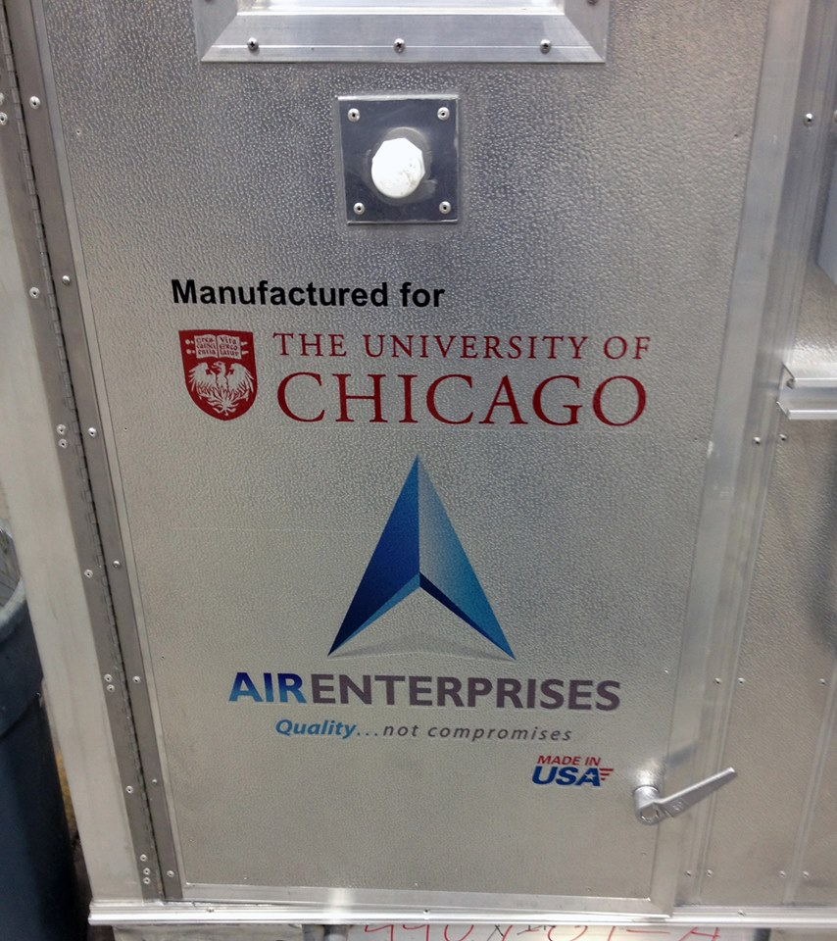
Air Enterprises-Smaller Scale FDI
Notes:
24

Slide 25
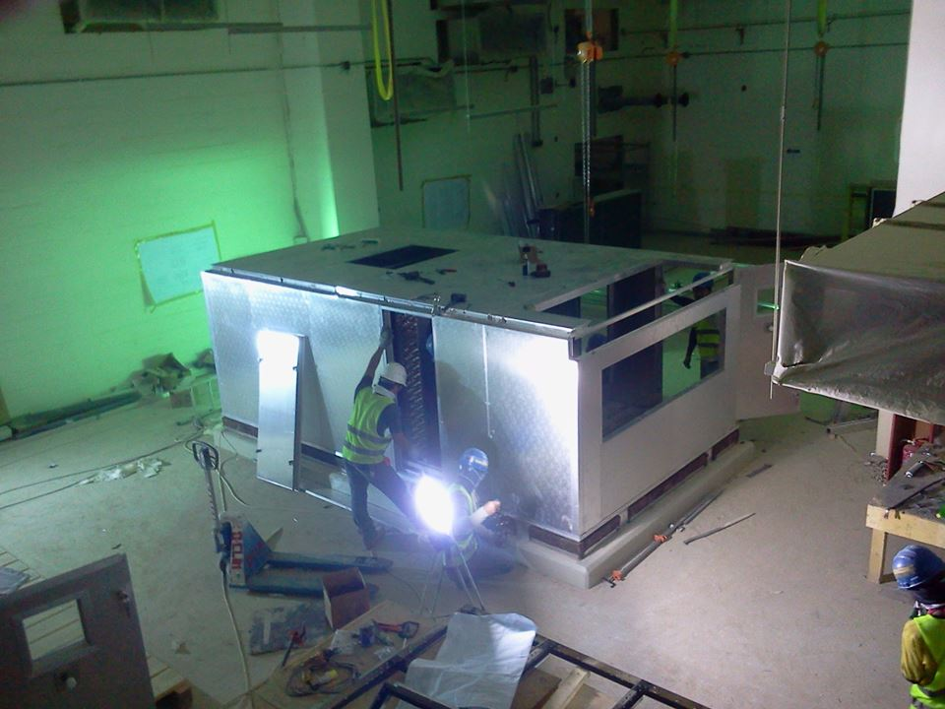
Air Enterprises HQ-Akron, Ohio, USA
Click to add content
Notes:
25

Slide 26
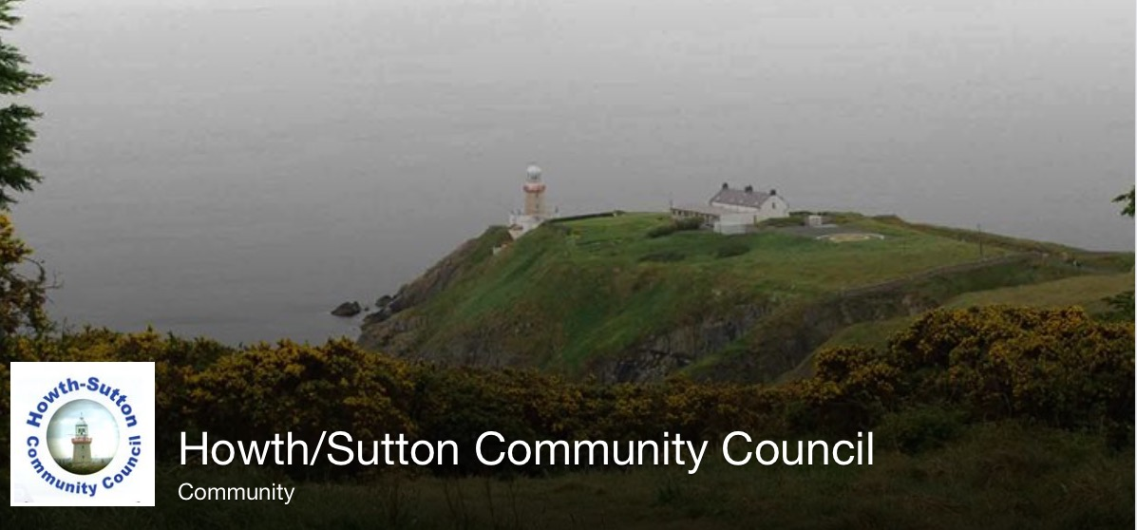
Civic Leadership
Notes:
26

Slide 27
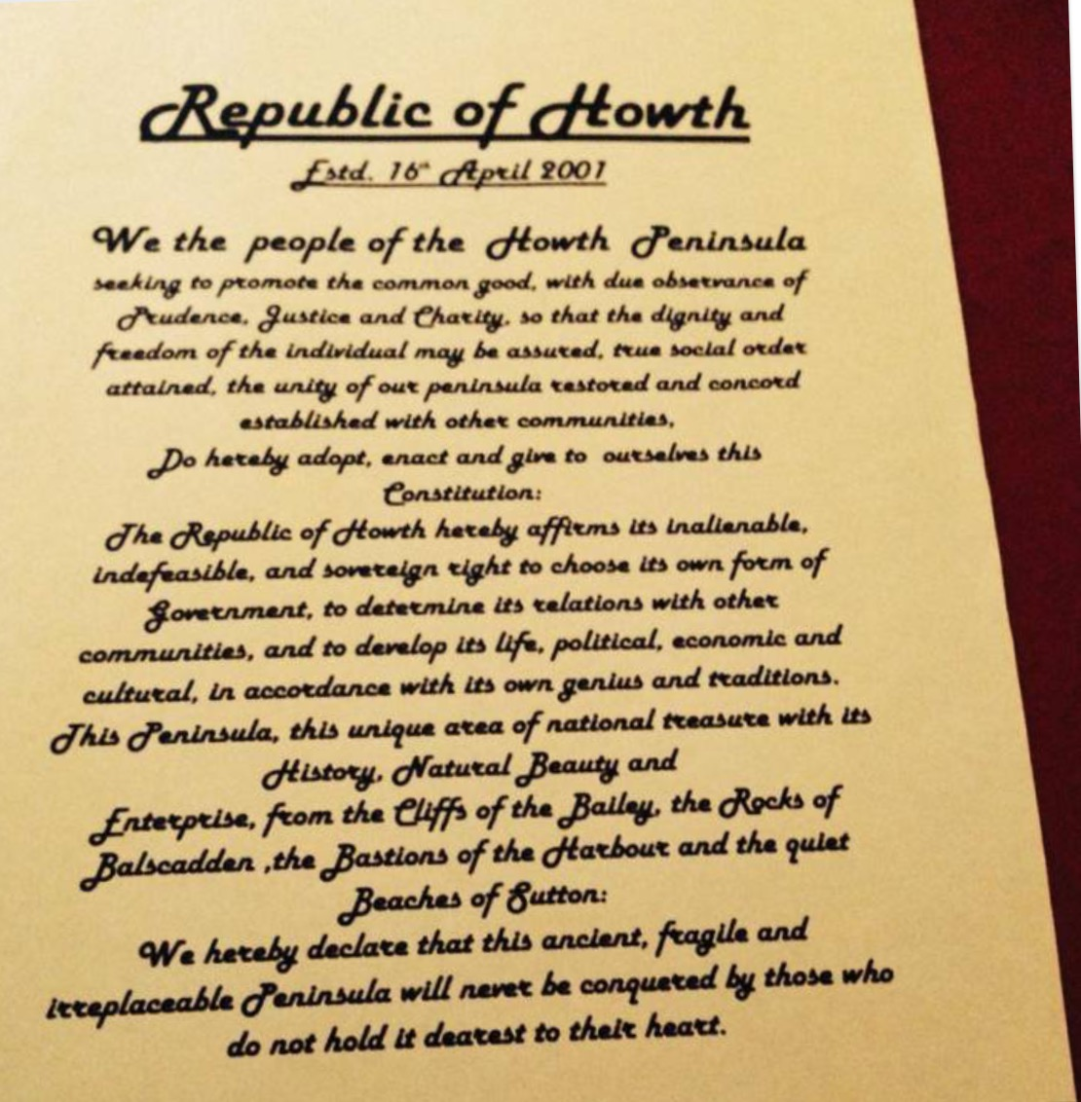
Proclamation
Notes:
27

Slide 28
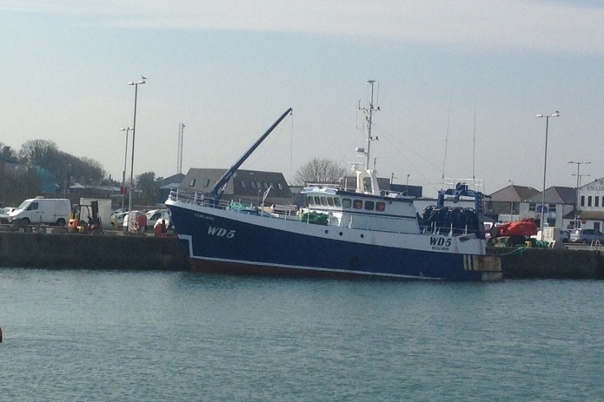
Howth Community-Urban & Rural
Notes:
28

Slide 29
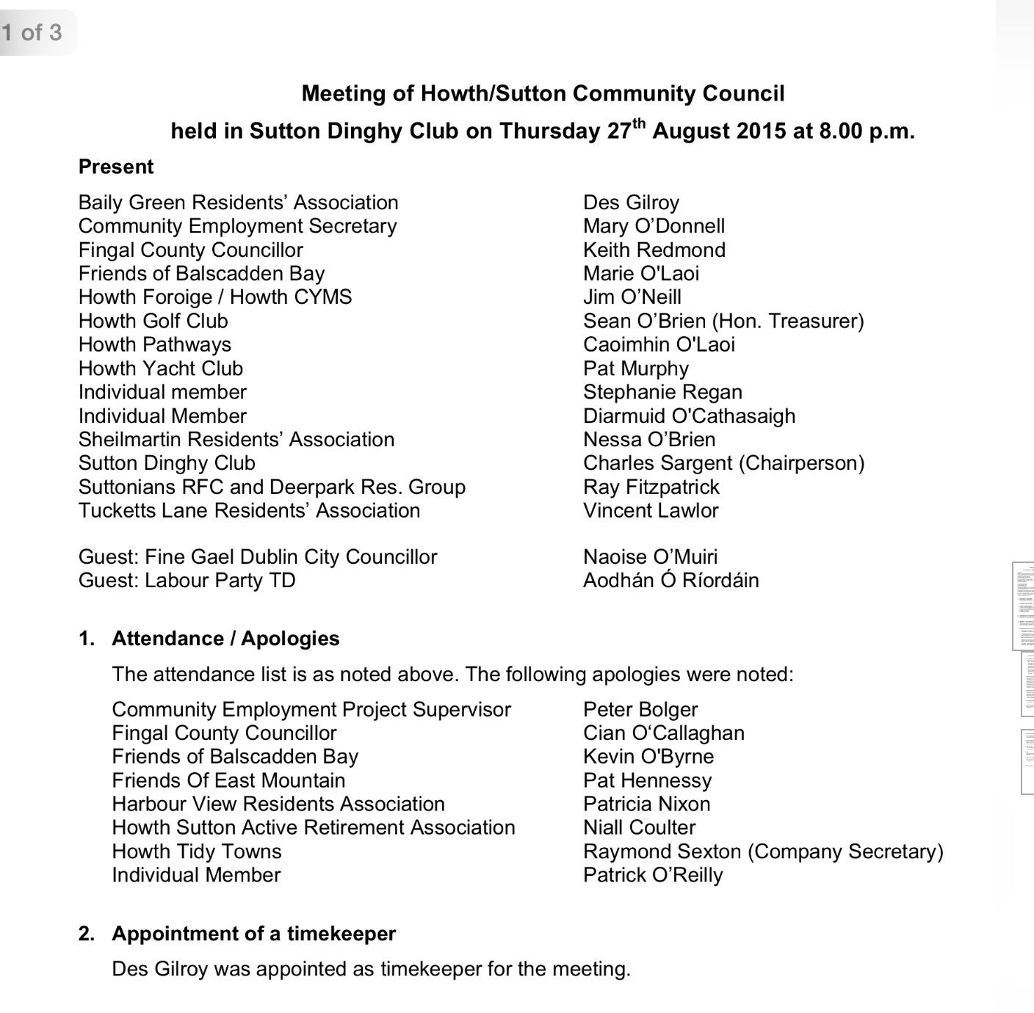
Rigour!
Notes:
29

Slide 30
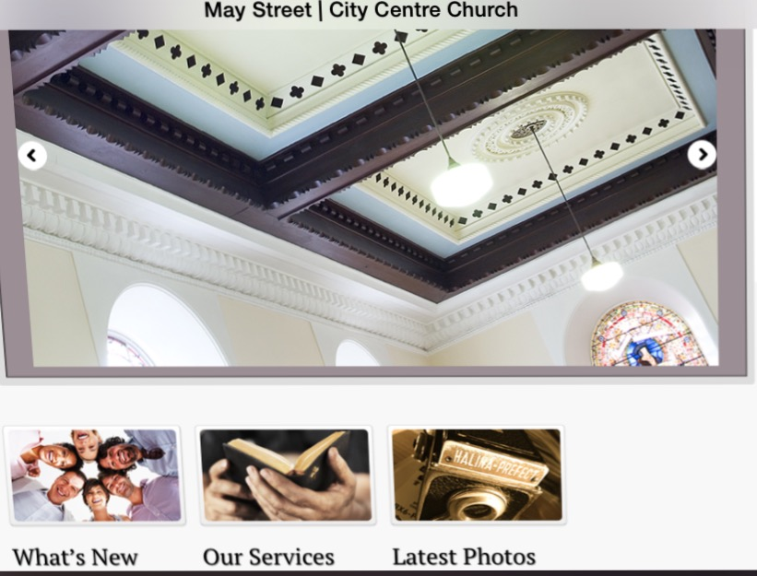
May Street, Belfast
Notes:
30

Slide 31
Bridging the Gap!
Notes:
31

Slide 32
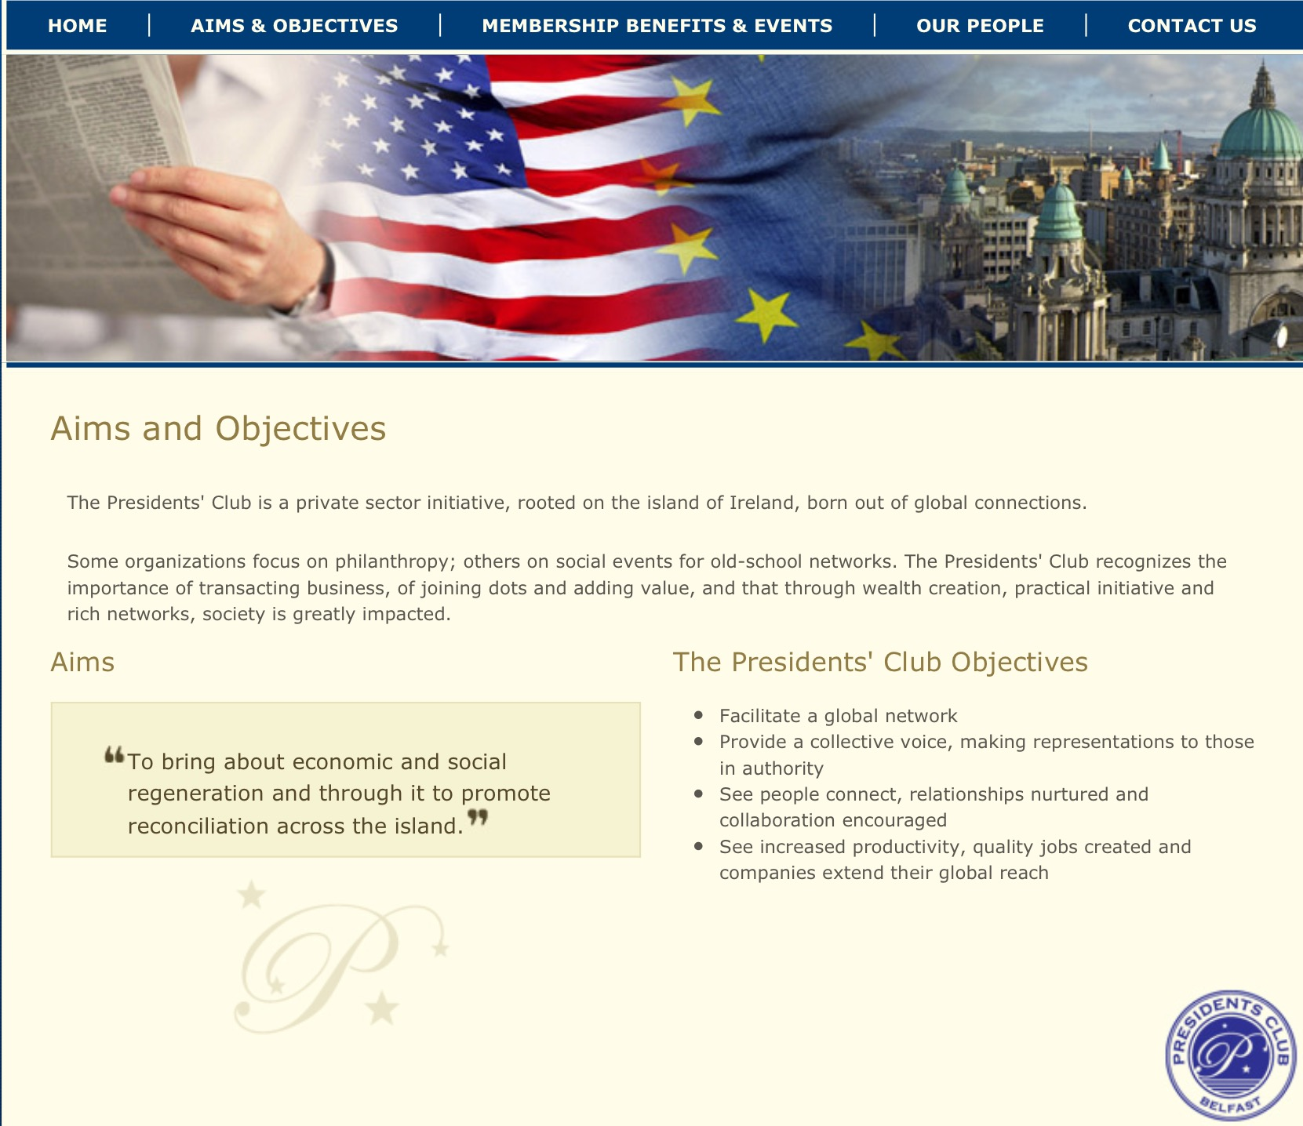
Economic & Social Regeneration
Notes:
32

Slide 33
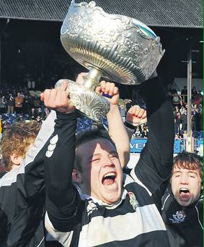
Holistic Success!
Notes:
33

Slide 34
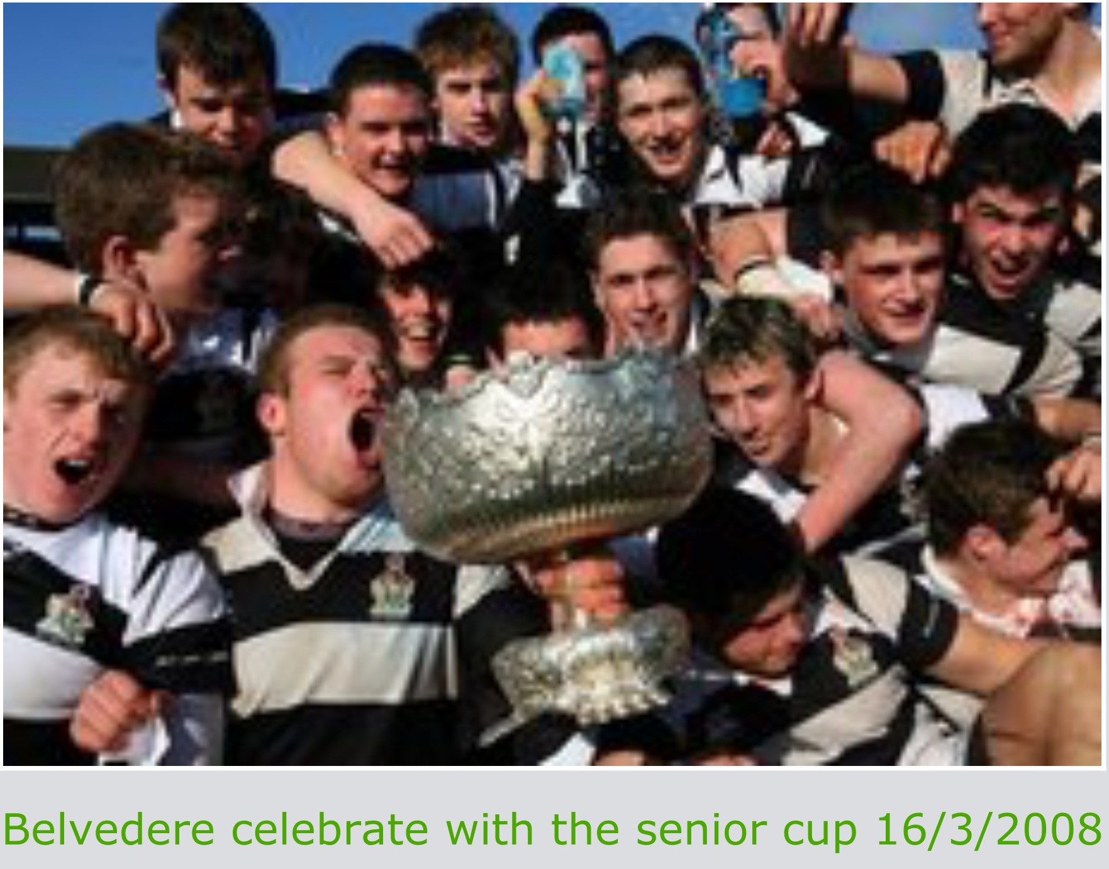
Teamwork
Notes:
34

Slide 35
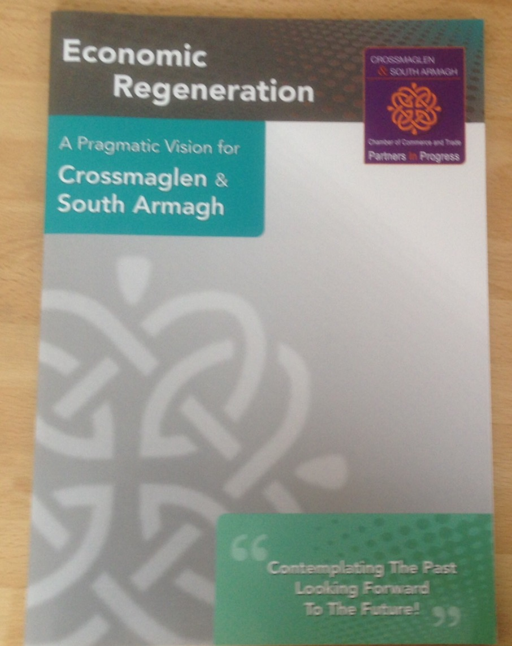
A Shared Vision
Notes:
35

Slide 36
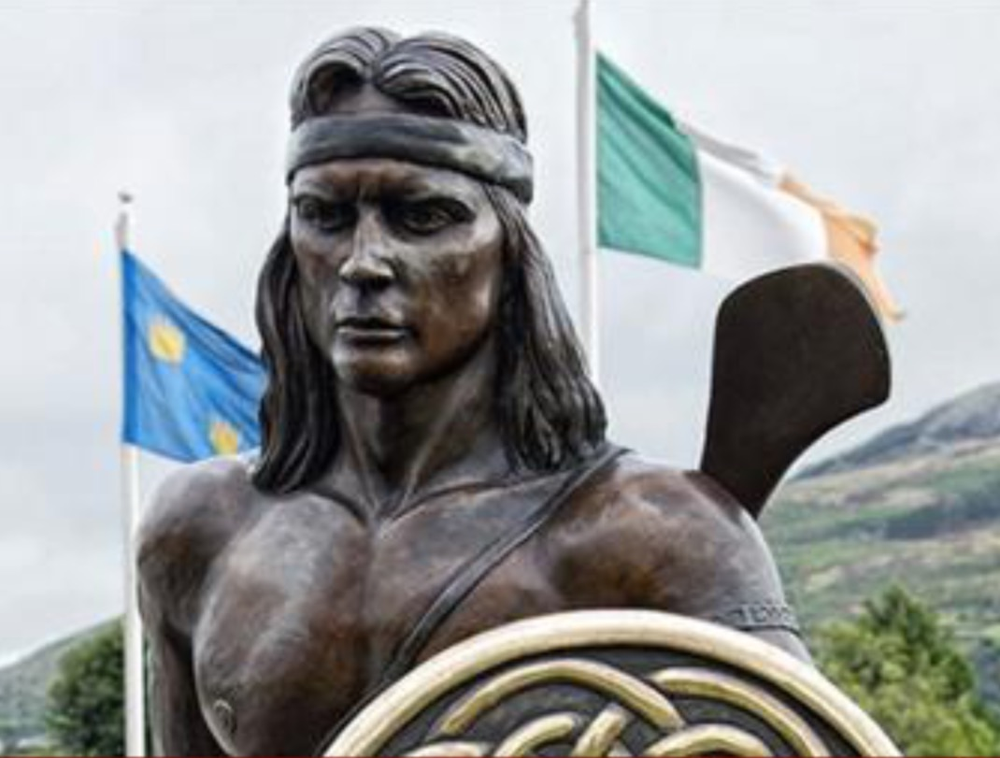
Peace & Prosperity
Notes:
36

Slide 37
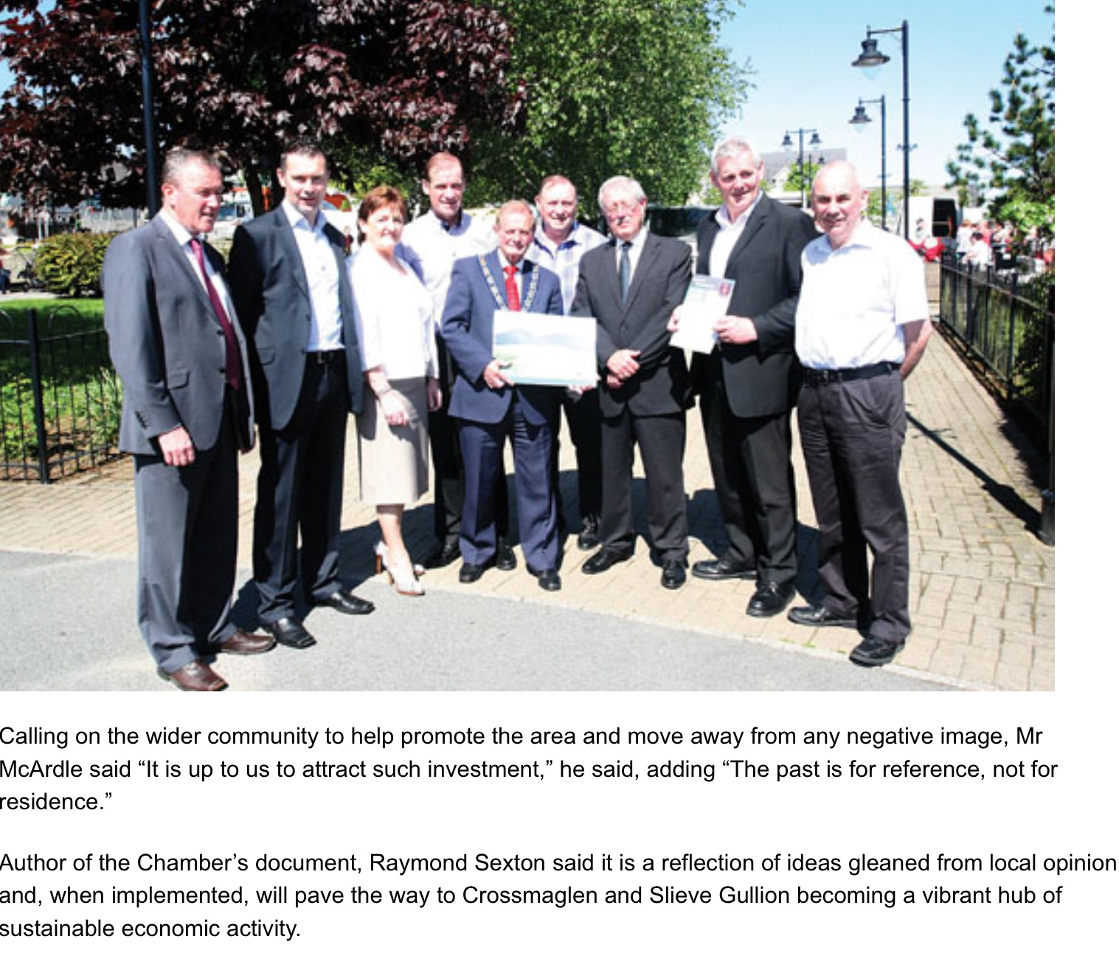
Painting a New Picture!
Notes:
37

Slide 38
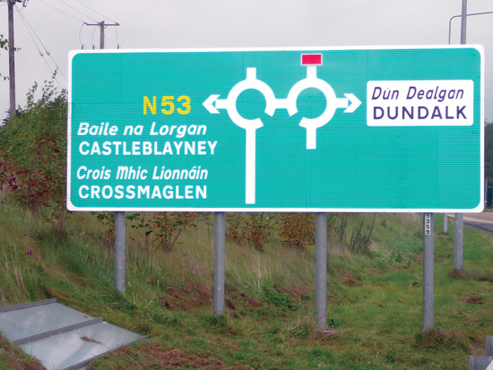
Blue Skies Over Gullion!
Click to add content
Notes:
38

Slide 39
Alone He Stands! Election 2011
Click to add content
Notes:
39

Slide 40
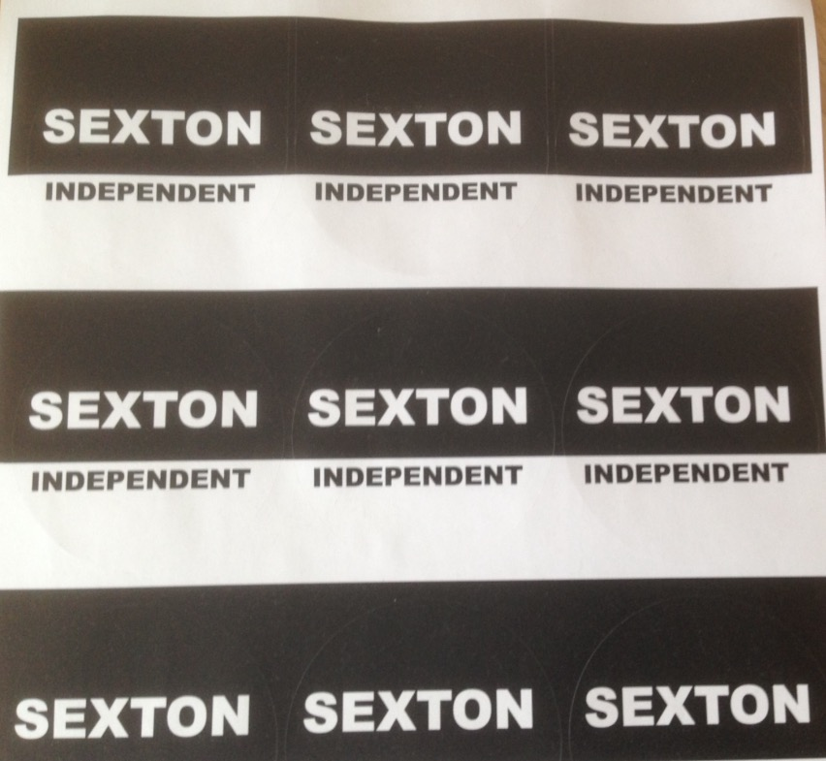
Detail, Detail, Detail
Notes:
40

Slide 41
User Requirements
Notes:
41

Slide 42
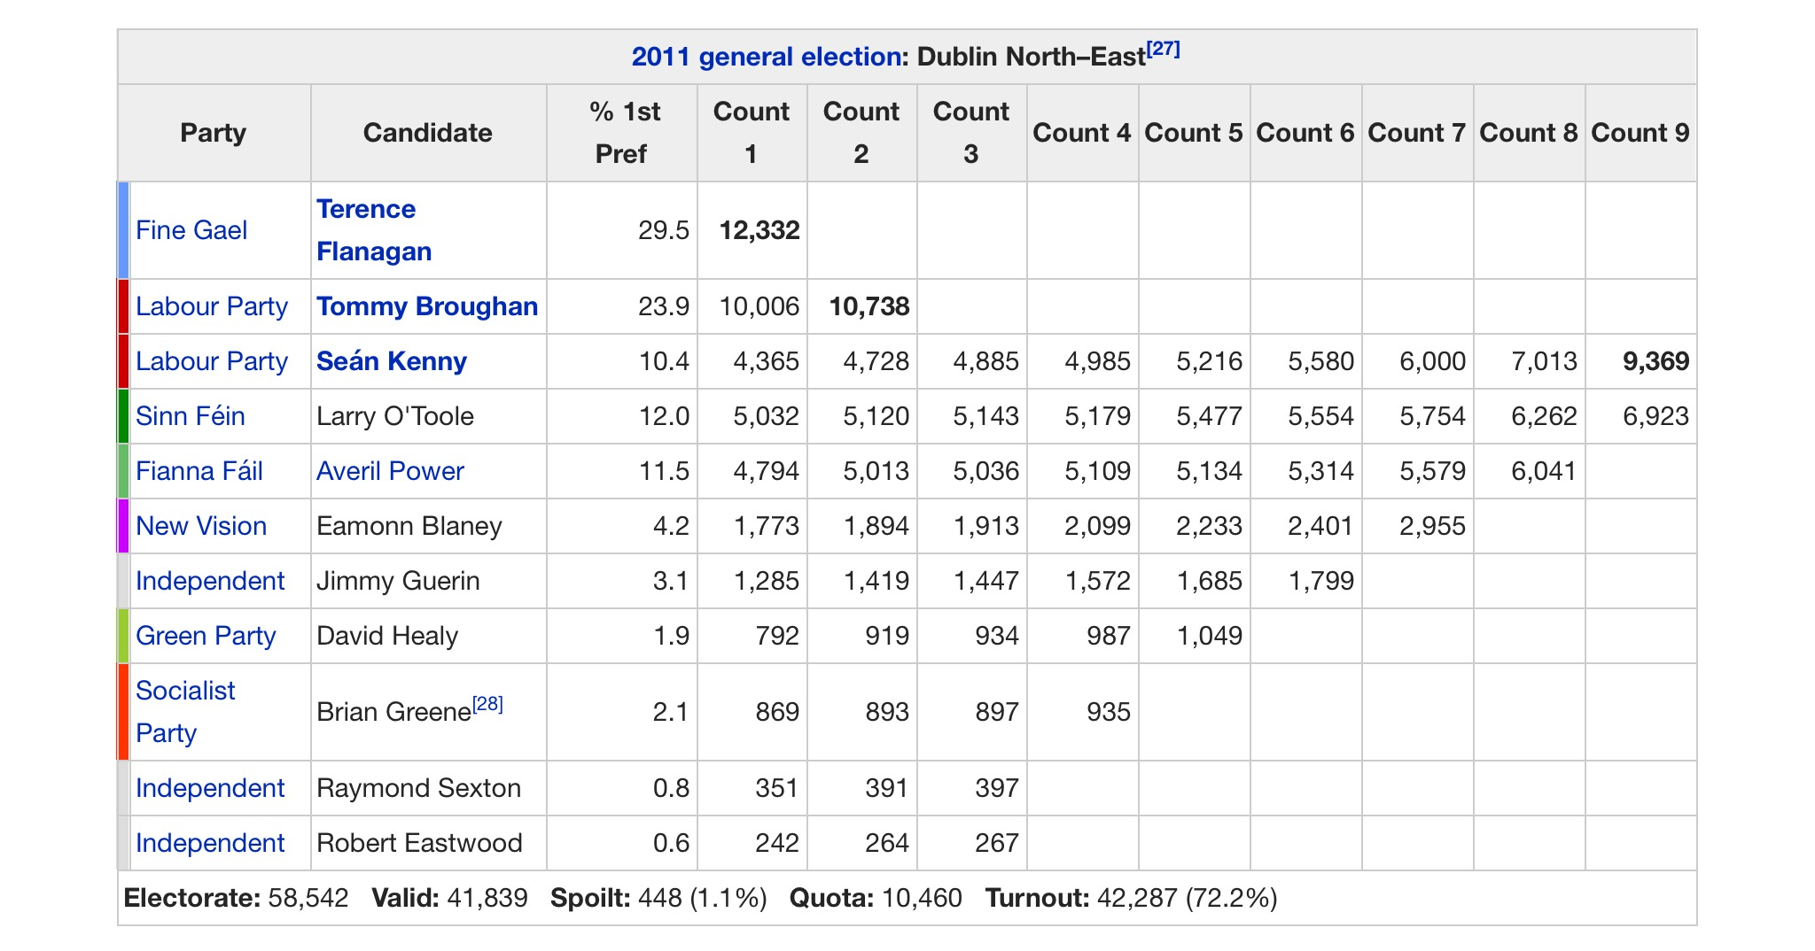
Keeping Score & Your Ego!
Notes:
42

Slide 43
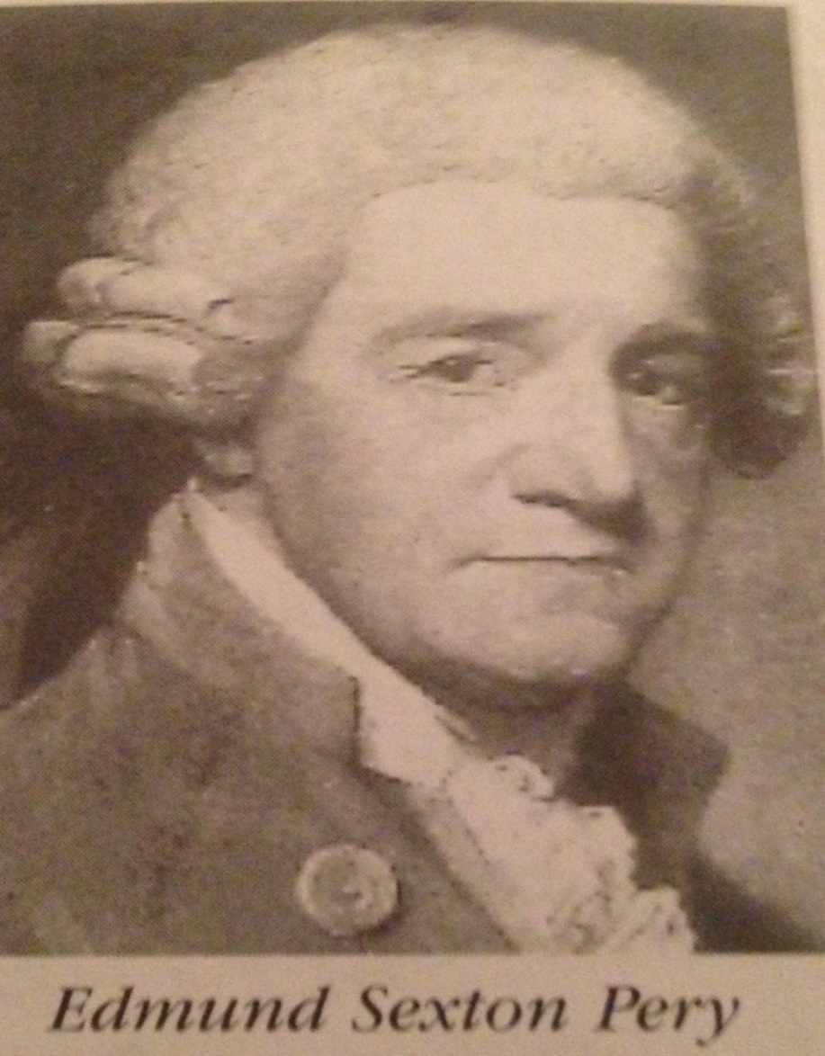
Heroes
Notes:
43

Slide 44
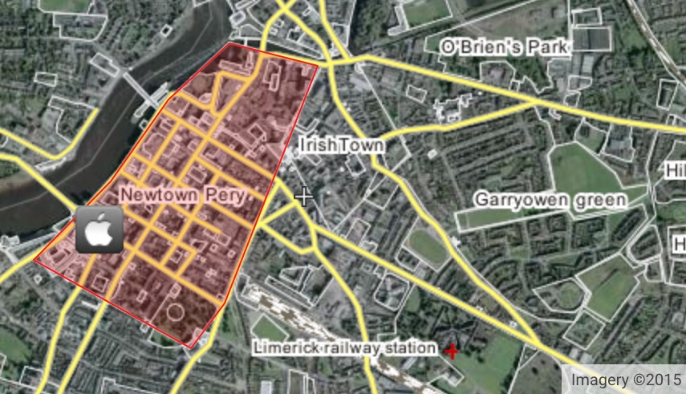
Newtown Pery
Notes:
44

Slide 45
Global Limerick Diaspora
Notes:
45

Slide 46
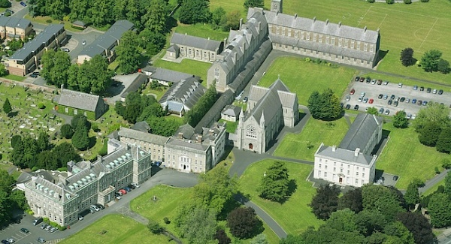
All Hallows College- Aisling 2017
Click to add content
Notes:
46

Slide 47
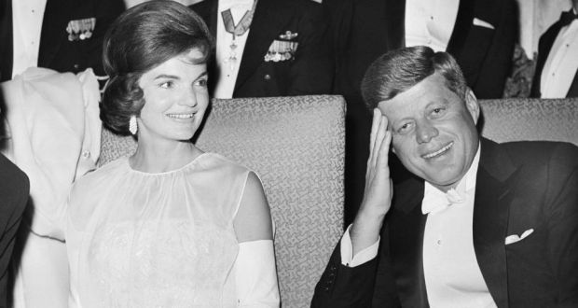
John & Jackie Kennedy
Click to add content
Notes:
47

Slide 48
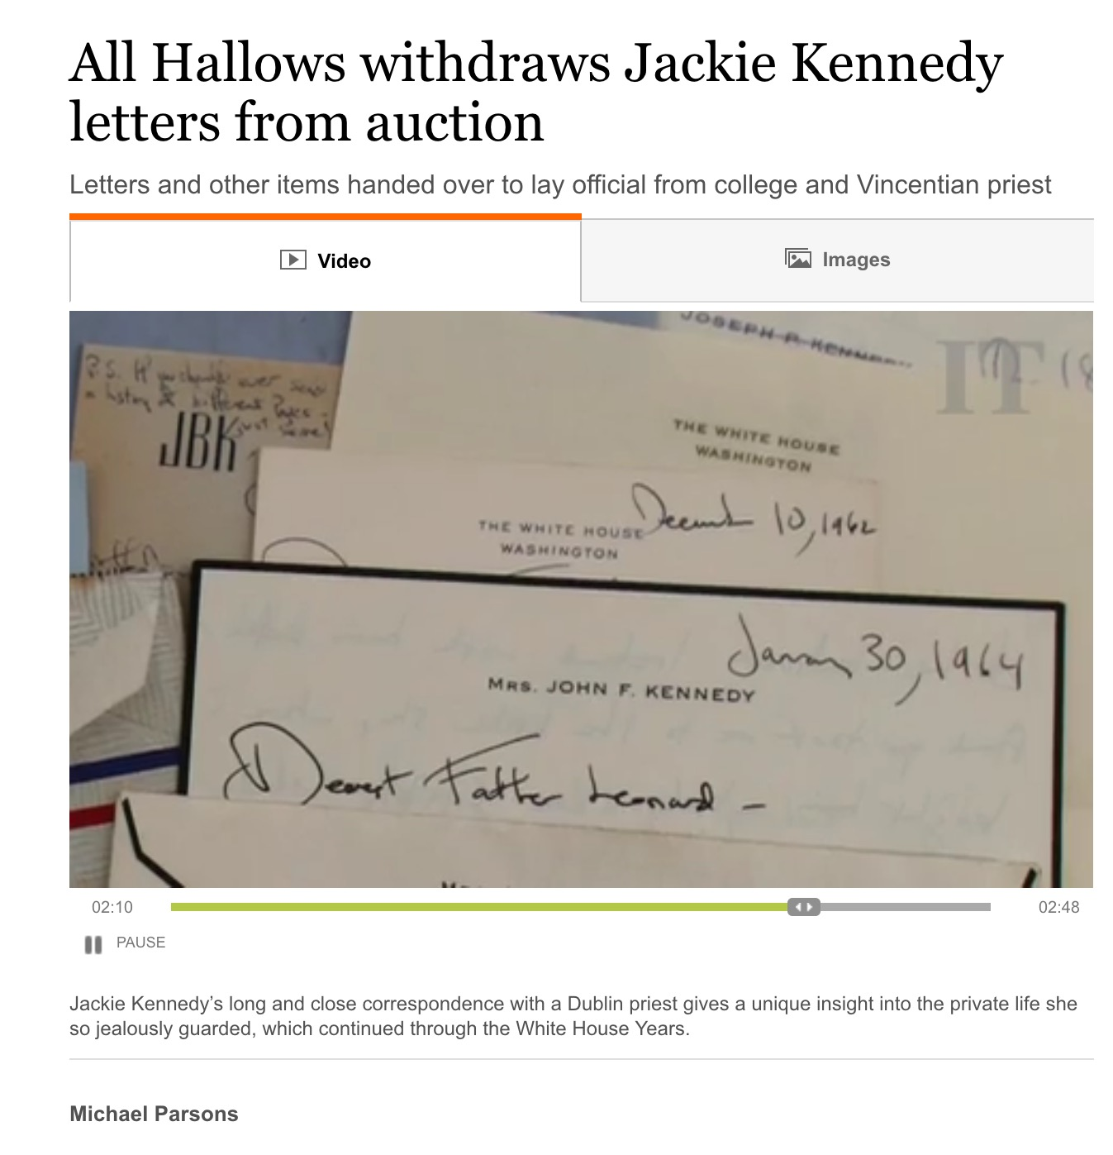
Art, Science or Bull?
Notes:
48

Slide 49
Positioning!
Notes:
49

Slide 50
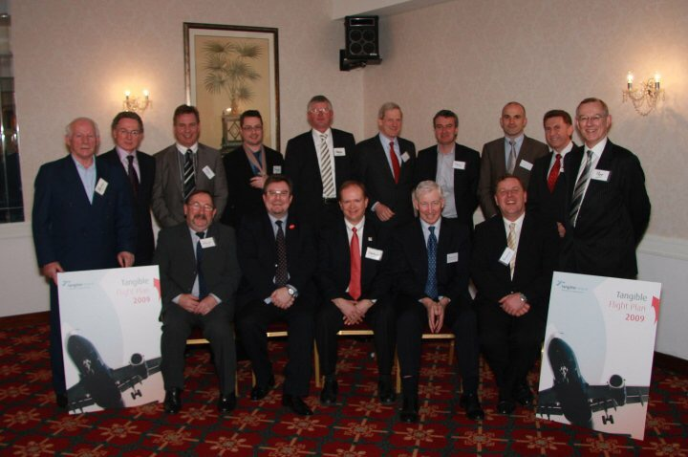
Original Tangible Flight Crew
Click to add content
Notes:
50

Slide 51
Tangible Art!
Notes:
51

Slide 52
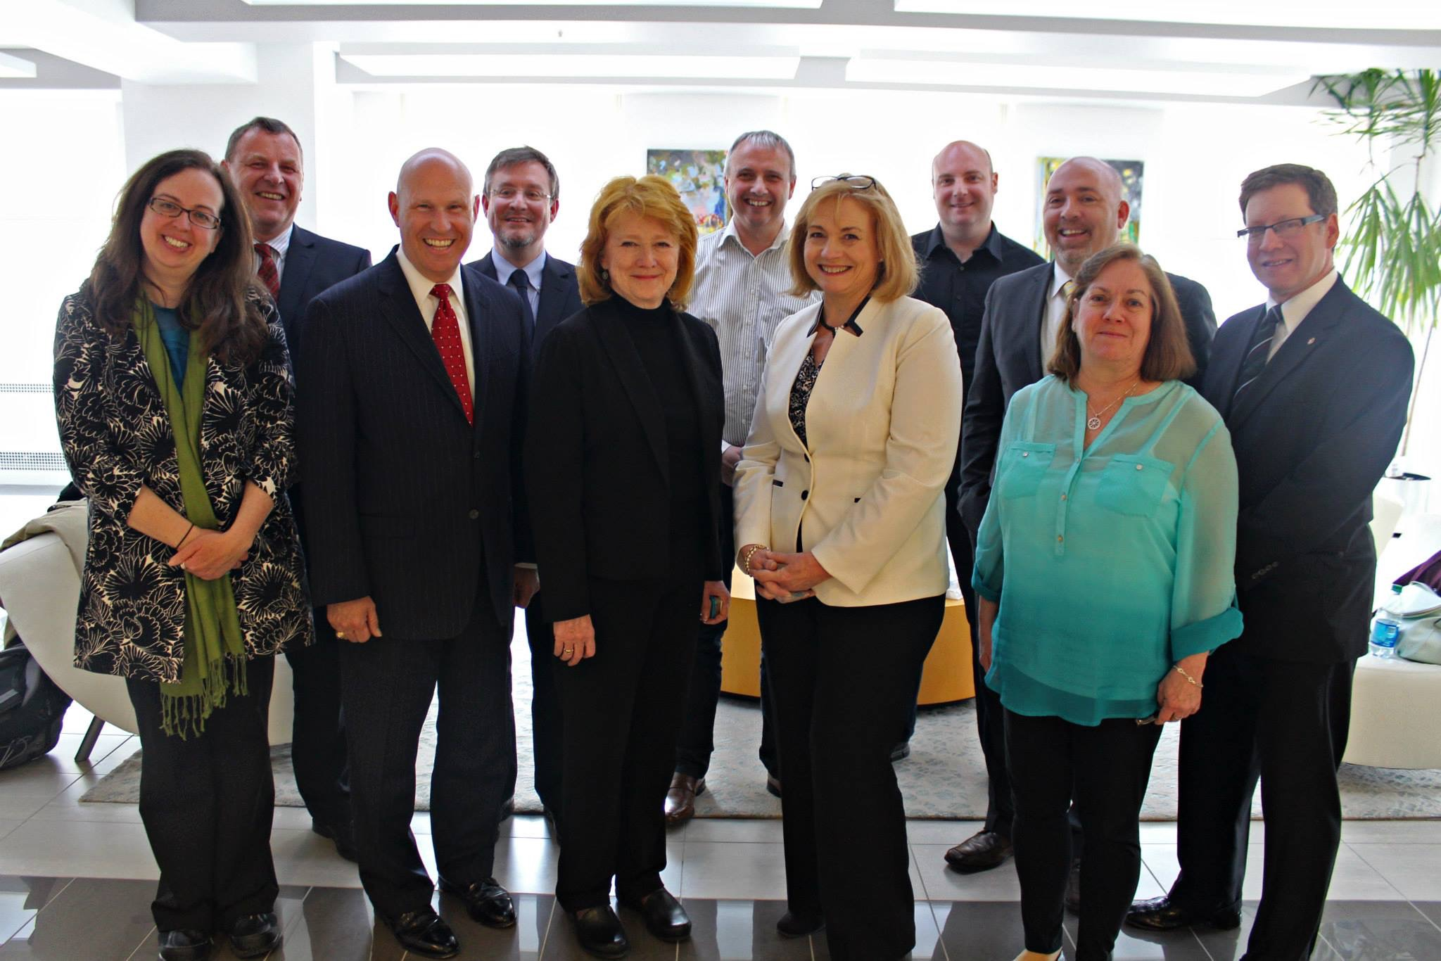
Tangible Ambassadors-New York
Click to add content
Notes:
52

Slide 53
Global Village
Notes:
53

Slide 54
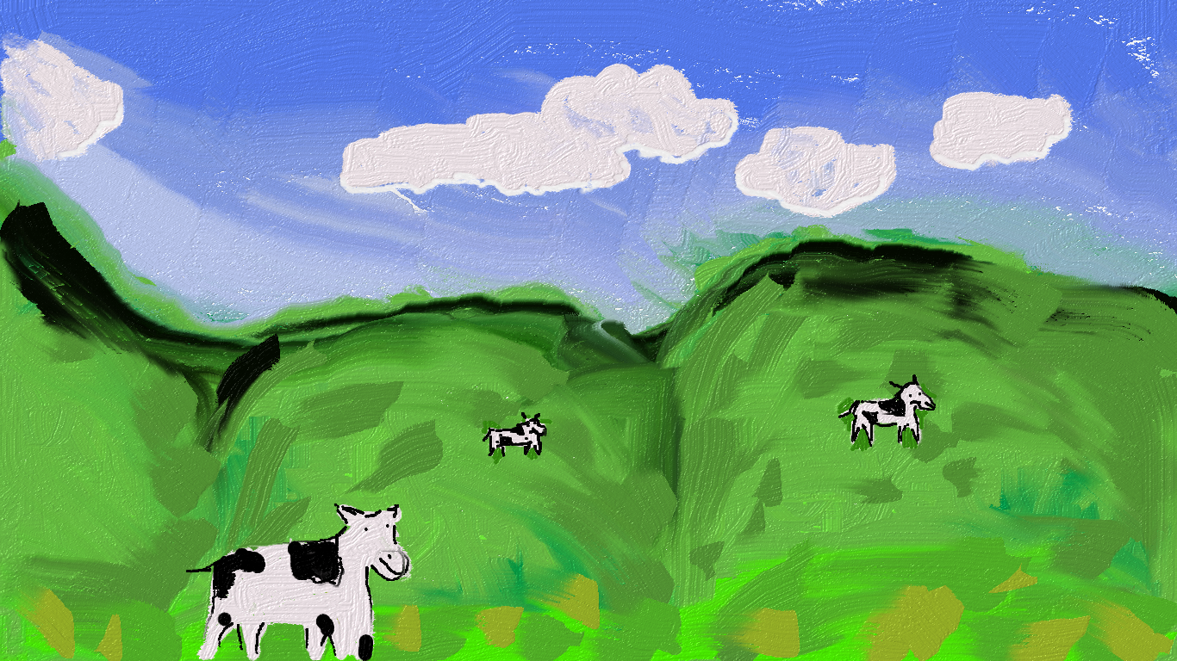
The Art
© Anna Sexton
Notes:
54

Slide 55
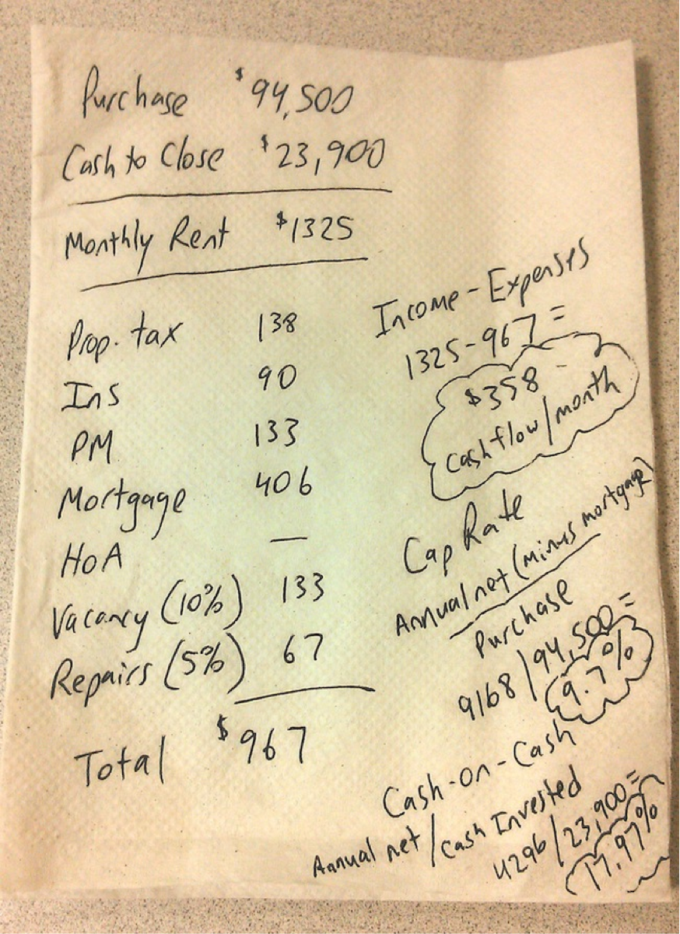
Simple Science-Back of the Envelope
Notes:
55

Slide 56
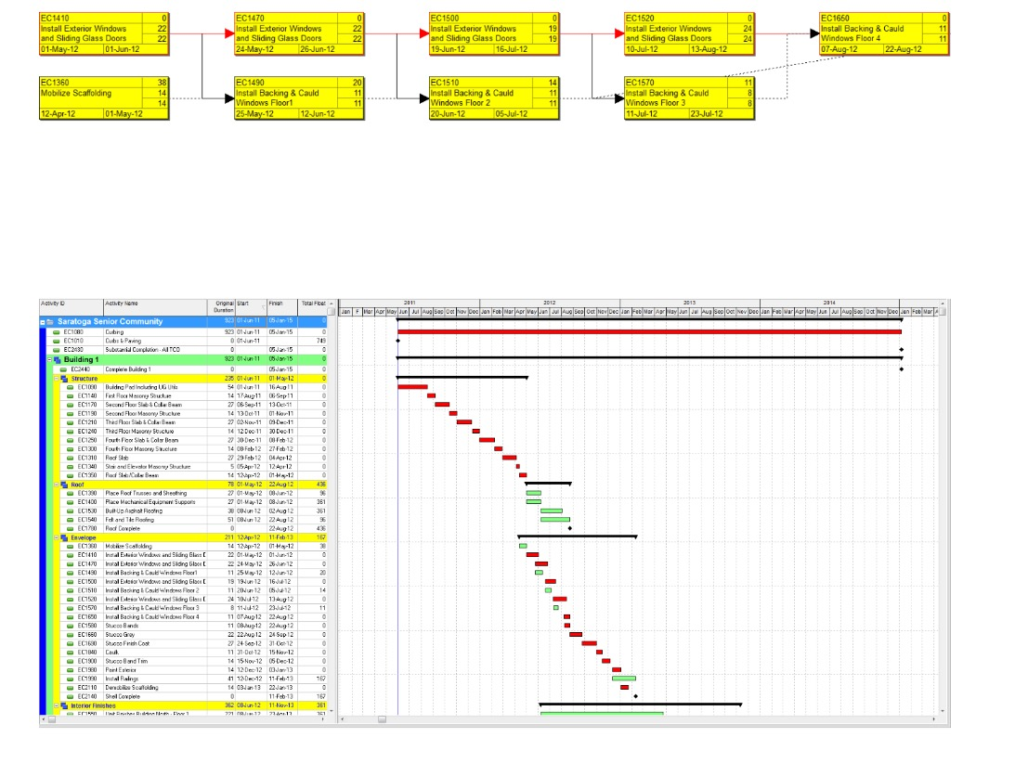
The Science
Notes:
56

Slide 57
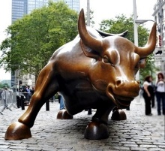
The Bull!
Notes:
57

Slide 58
It’s Art, Science and Bull!
Good Luck and Thank You!
Notes:
58

